Slide 1
Year 12 Parents Welcome Webinar
Strive | Pride | Simple | Respect
September 2022

Slide 2
CLICK RECORD

Slide 3
Agenda
Introduction – JJ
Teaching and Learning – Andy and Alice
Pastoral Support and Industry Standards – Sophia
Life After Global Academy – JJ
Q&A - All

Slide 4
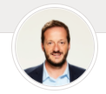
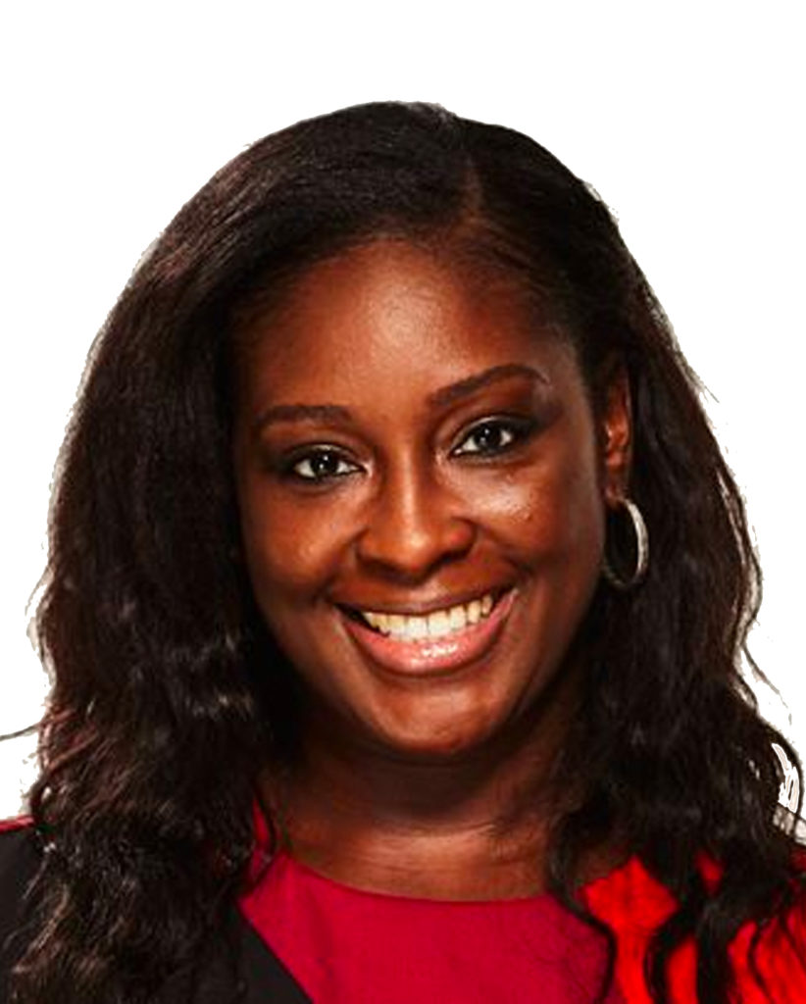
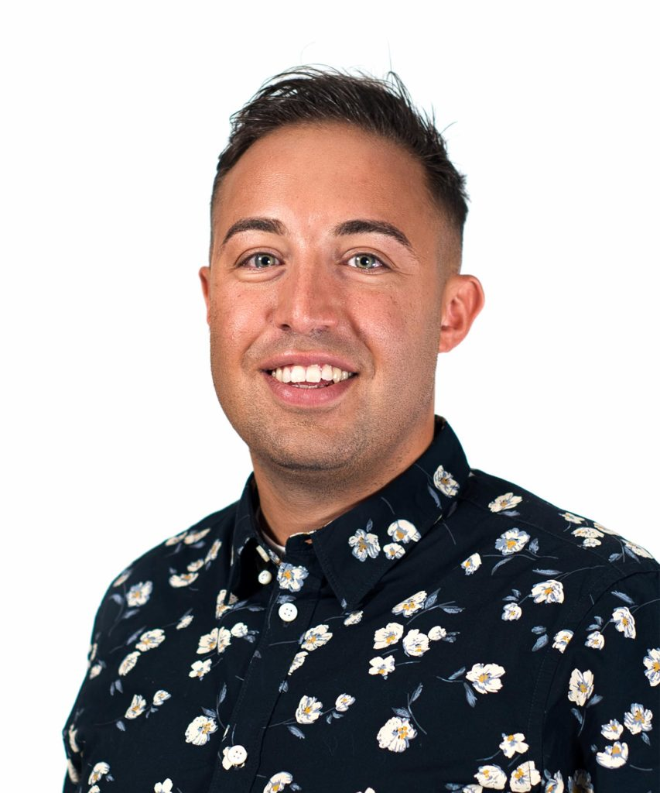
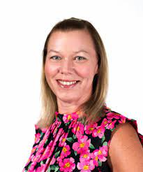
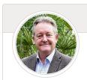
Senior Leadership Team
Jonty Archibald
Principal
Sophia Martin
Vice Principal: Behaviour & Safety
KS5 Pastoral
Jonathan Jacob
Director of Specialism
Media
Neil Knowles School Business Manager
Jayne Voice
Vice Principal:
Core Curriculum & SENCO

Slide 5
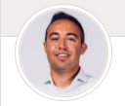
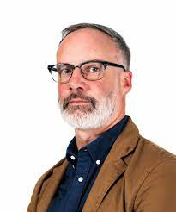
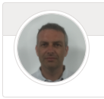
KS5 Team + media teachers
Jonathan Jacob
Director of Specialism
Media
Sophia Martin
Vice Principal &
KS5 Pastoral Lead
Mark Pendergast
Head of Content Youths Choice
Andy Winter
KS5 Curriculum & Digital Lead

Slide 6
Safeguarding & SEND
Preya Dhanecha
Head of Safeguarding
Designated Safeguarding Lead (DSL)
Sophia Martin
Vice Principal
Deputy Designated Safeguarding Lead (DDSL)
Jayne Voice
Vice Principal
& SENCO

Slide 7
“Parental support is eight times more
important in determining a child’s
academic success than any other
factor.”

Slide 8
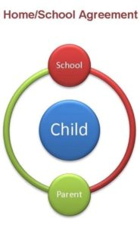
Our Commitment to You
Communication with KS5 Parents:
Half Termly Sixth Form Update Letter – overview of projects and highlights
Termly Report – Grades, ATL
Intervention if needed (1-2-1s, scaffold, chunking, Pathway Lead, Leadership, Parental Contracts)
Progress Evening – Face to Face
The Role of KS5 Media Mentor
Weekly Careers Newsletter (FYI)
Social Media Updates (@theGAcademy)

Slide 9
What is my child studying?
Pathway (Main Study Focus)
G:CL
Social Media
Technical Training
G Prepare
+ GCSE Retakes (if required)
Timetabled lessons are compulsory

Slide 10
What else?
Global Pastoral Care, Super Curriculum and Enrichment
Media Mentor (Pastoral Support)
SEND Support Plans and 1-2-1s
FREE Adobe Industry Software
Industry Opportunities
Industry Led Drop Down Days
Classroom Drop In
Access to exclusive “Global” events and tickets
Super Curriculum – Youths Choice Radio and YouTube
Sports Hall - KS5 Wellbeing Drop In
Book specialist media kit for personal projects
Book out Radio, Vision and Music studios for personal passion projects
Be a Mentor for KS4 (additional qualification)
Get an Industry Mentor
Student Voice
Jack Petchey Awards
EDI Projects – Pride in London, Culture Week, Black History Month, Disability Awareness .etc

Slide 11
GCSE Resit Dates
Monday 31st October
GCSE English Paper 1
Tuesday 1st November
GCSE Maths Paper 1
Wednesday 2nd November
GCSE English Paper 2
Thursday 3rd November
GCSE Maths Paper 2

Slide 12
Teaching and Learning
Andy Winter

Slide 13
Role of the KS5 Media Mentor
Students' Main teacher
Monitors academic, attendance and behaviour progress
Link between Academy and home
Monitors and enforces Home School Agreement
Supports Media Passion Projects
Supports Career Progression e.g., UCAS

Slide 14
UAL Qualifications
The course will provide students with
opportunities to develop and utilise broad,
transferable skills by encouraging an ethos of
personal and professional development.
These include:
• Initiative independent inquiry
• Creative thinking
• Reflective learning
• Team-working
• Self-management
• Effective participation
• Problem solving
• Communication.

Slide 16
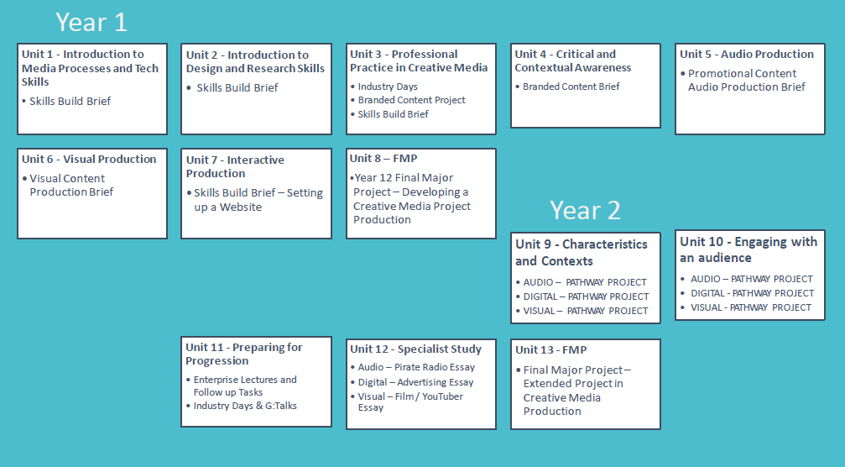
Content Production
The UAL Level 3 Extended Diploma in Creative Media Production and Technology
has been designed to provide students with the knowledge, skills and understanding necessary to access and progress to degree-level study and employment in the media sector

Slide 17
Creative Enterprise
Contact: Alice Smith-Allen alice.smith-allen@globalacademy.com
Finance
Social Media platforms, campaigns and analytics
Marketing and Branding
Pitching, communication and reflection skills
Strategy, advertising and promotion
Working with live briefs and clients

Slide 18
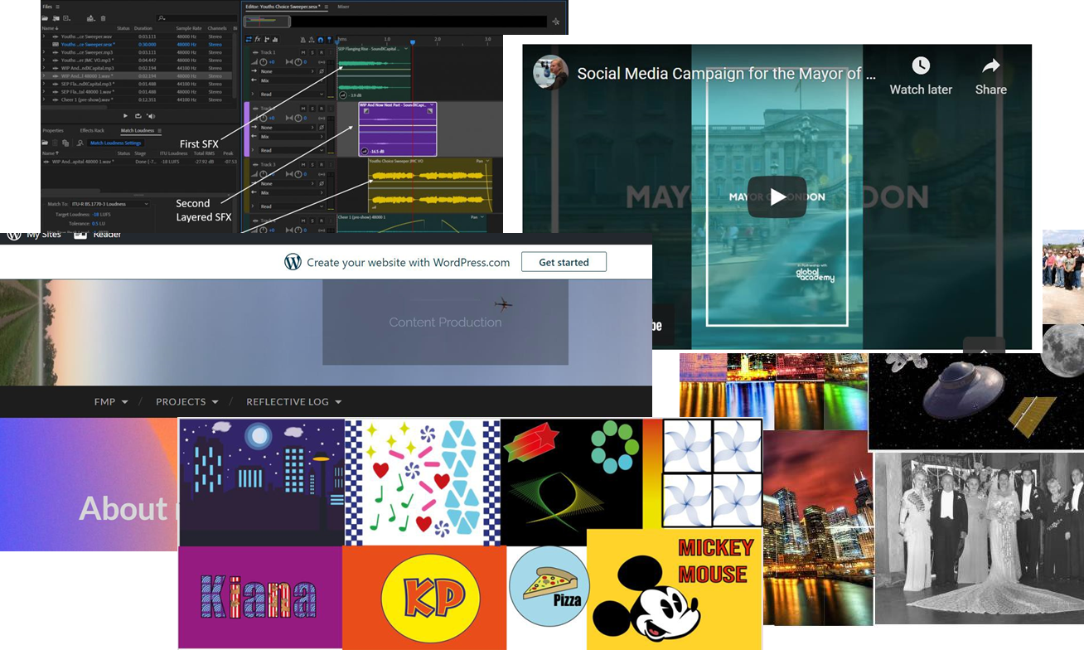
Examples of Work
Audio
Video
Digital
Enterprise

Slide 19
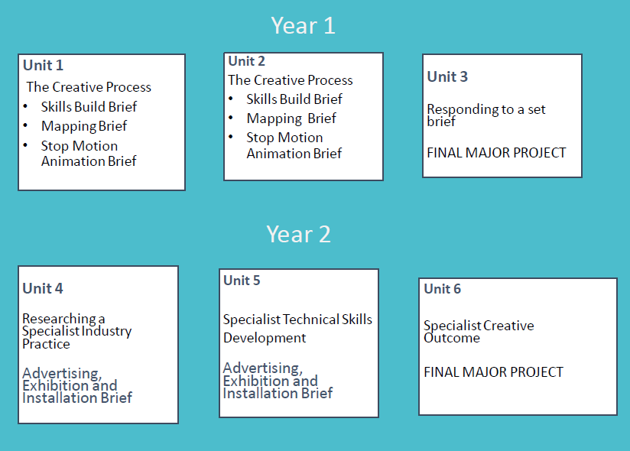
Digital Design
The UAL Level 3 Diploma and Extended Diploma in Creative Practice: Art, Design, and Communication are qualifications for post-16 students looking to pursue a specialist career in the creative industries.
The qualifications provide students with the necessary industry relevant skills, knowledge, and understanding to access appropriate entry level roles, training programmes or apprenticeships in the creative sector, or apply for progression to related higher education courses

Slide 20
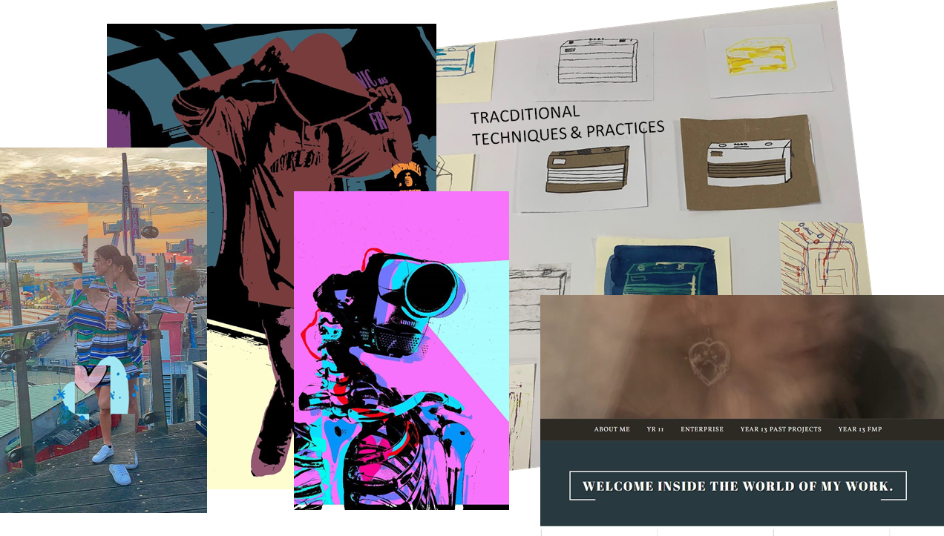
Examples of Work
2D
3D
4D

Slide 21
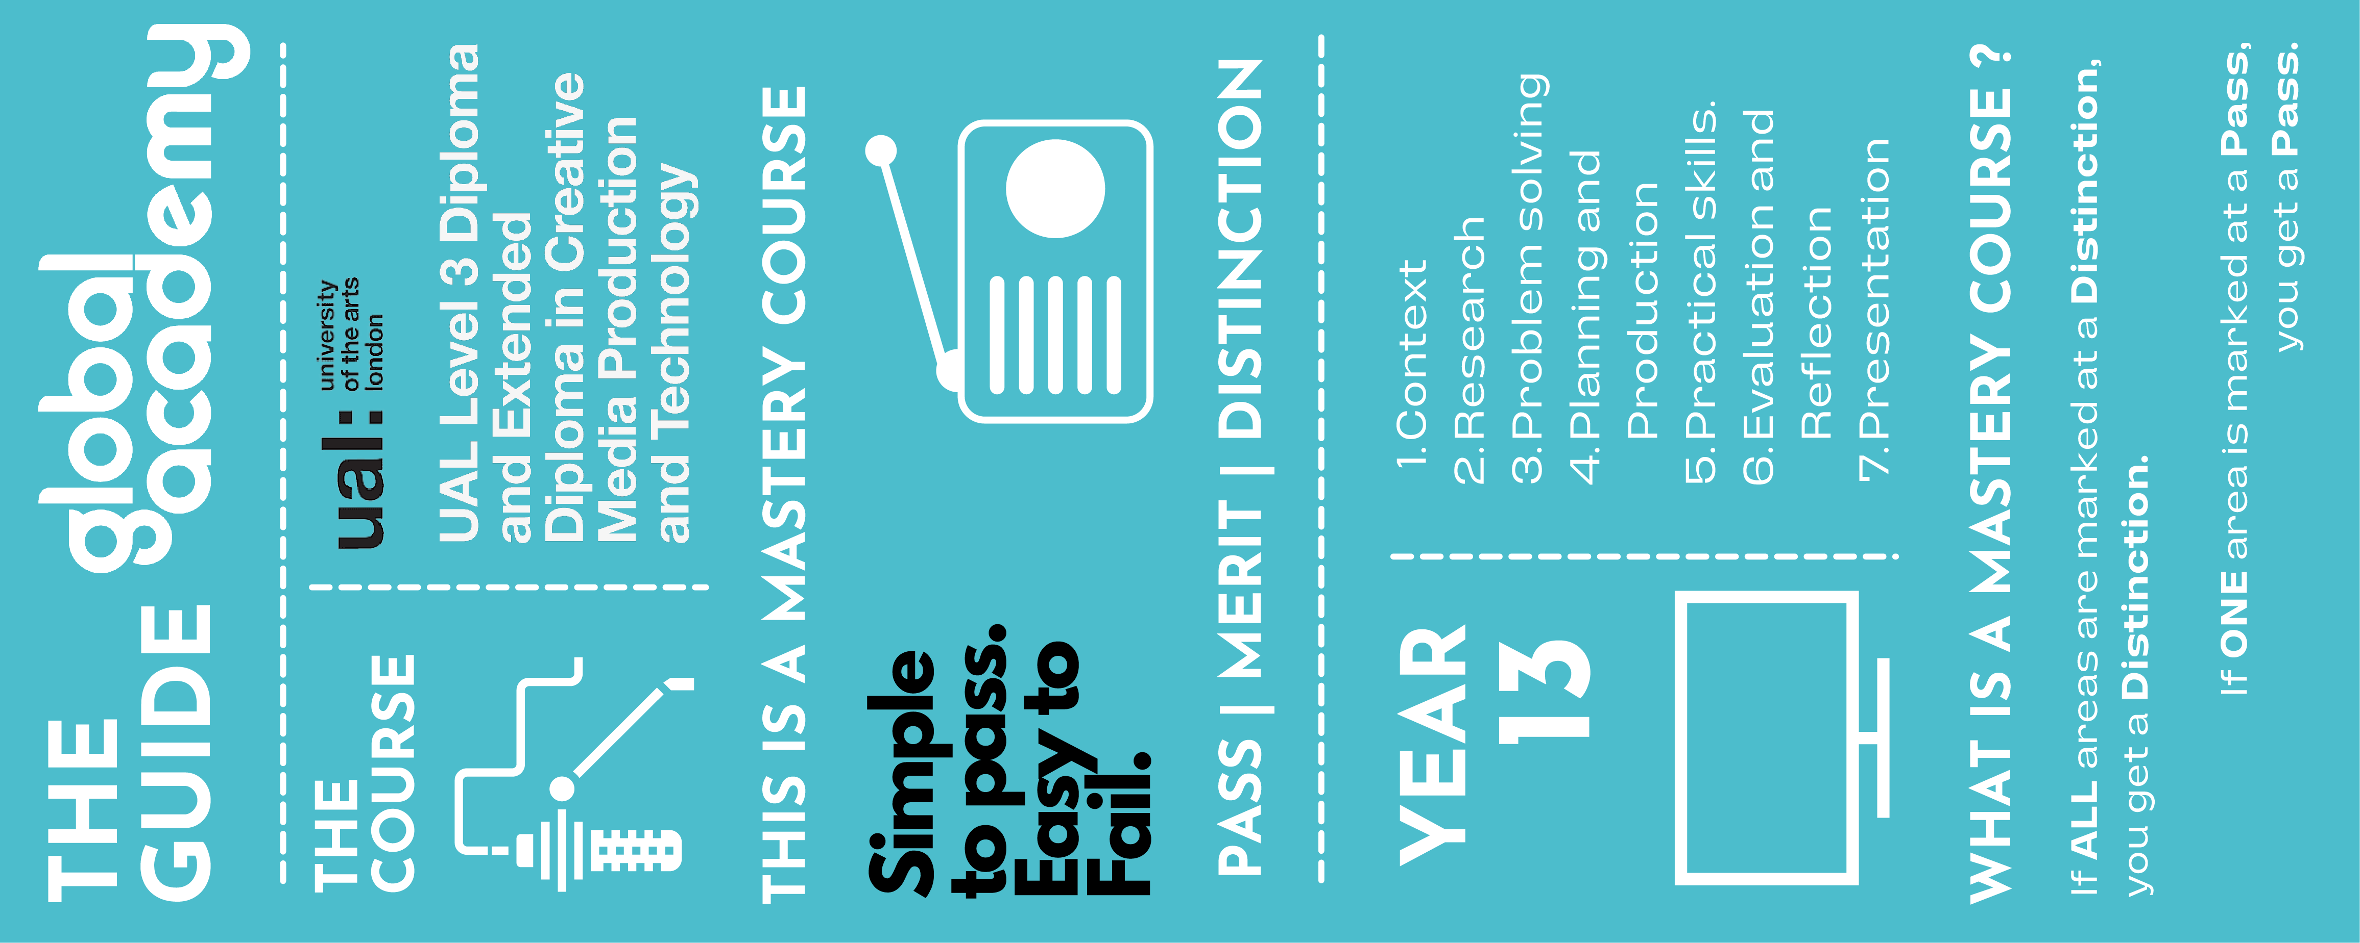
What is an FMP?
Example of
Digital Design FMP
Example of
Content Production FMP

Slide 22
Level 2
Contact: Alice Smith-Allen alice.smith-allen@globalacademy.com
1 year course- Finish EASTER
Level 2-RSL qualification- Vocational course
Pass, Merit, Distinction
Fail a unit- Fail the course

Slide 23
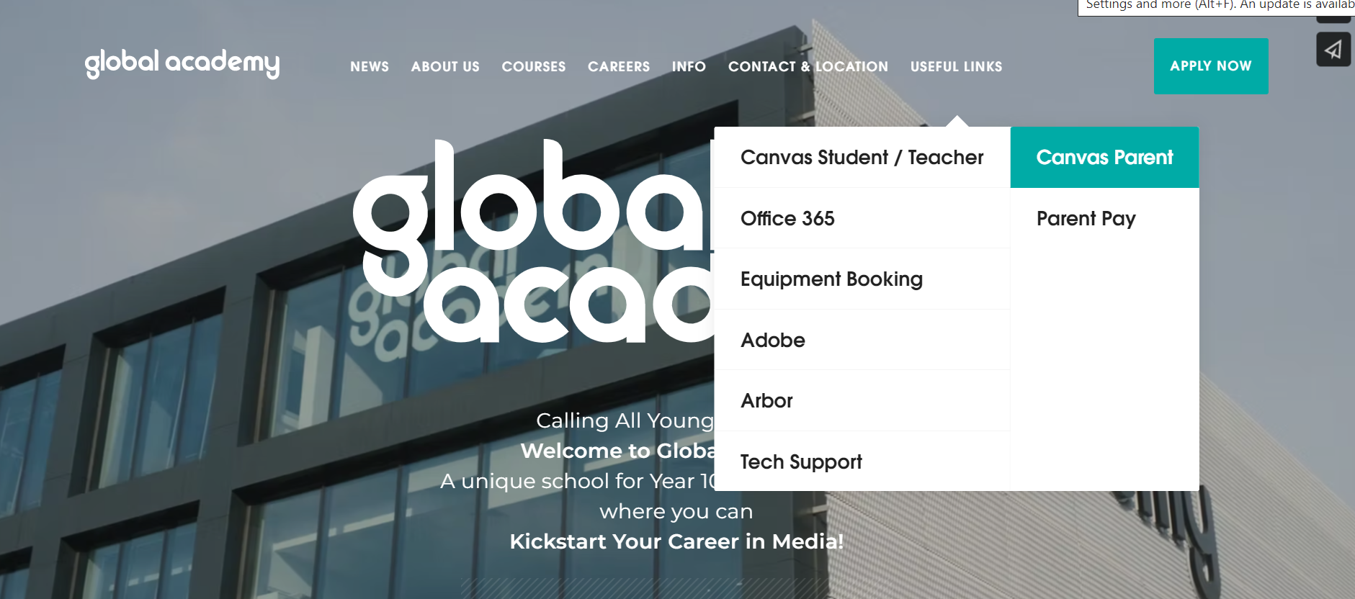
How can I support my child with their learning?

Slide 24
Industry Standards and Pastoral Support
Sophia Martin

Slide 25
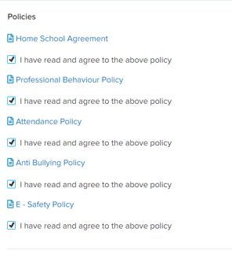
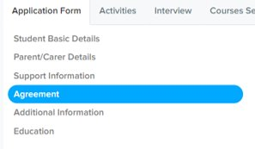
Your Application to Year 12

Slide 26
Our Core Values
Democracy
The Rule of Law
Individual Liberty
Mutual Respect
Tolerance of those of different faiths and beliefs
F
B
V

Slide 27
Industry Ready
We expect the highest standards of behaviour at Global Academy and Global HQ
We expect to see those high standards in the classroom, studios, around the building and in our community
Global Academy : Professional – Industry – Behaviours

Slide 28
Professional Industry Behaviours
Policies on website
Attendance
Professional Behaviour
E-safety
Safeguarding
Strive | Pride | Simple | Respect

Slide 29
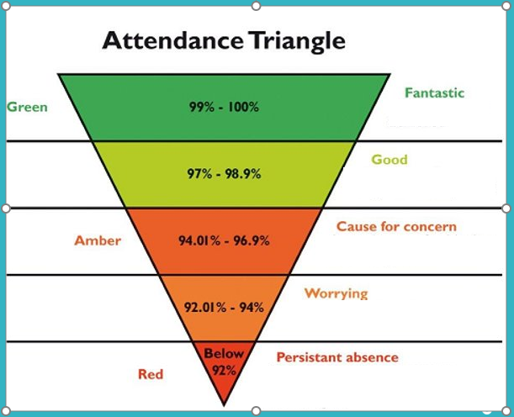
Attendance & Punctuality Matters
Strive | Pride | Simple | Respect

Slide 30
Persistent Absentees (PA’s)
A Globaller will become a ‘persistent absentee’ when you miss 10% or more of education over an academic year for whatever reason
Therefore, attendance below 90% = persistent absence
Absence at this level is doing considerable damage to your educational, apprenticeship or career prospects
Missing Sixth form will make you fall behind in lessons, opportunities and media related skills building
This will impact on your academic progress and achievement
Strive | Pride | Simple | Respect

Slide 31
Absence Procedure
Contact the Academy before 8.00am on the first day of absence and any subsequent days of absence
Send an email and/or provide medical evidence on the first day of return with an explanation, even if you have telephoned
Contact via phone, 0203 019 9000 or email: attendance@globalacademy.com
Strive | Pride | Simple | Respect

Slide 32
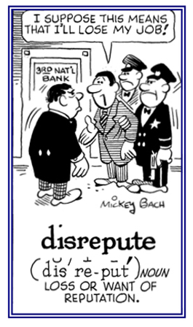
E- Safety Policy
Students must not upload staff or students on to social media or messaging platforms without their consent;
Students must not create posts that will bring Global HQ or Global Academy into disrepute

Slide 33
Strive | Pride | Simple | Respect

Slide 34
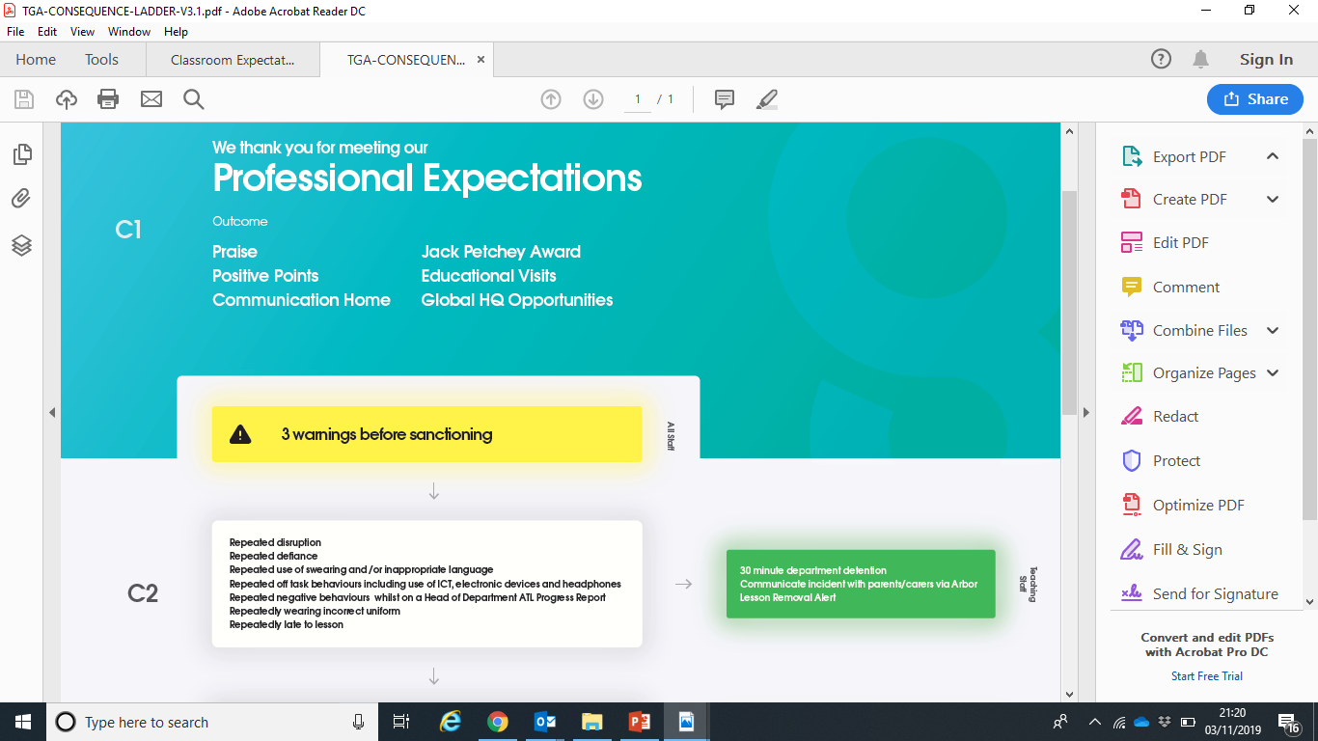
Professional Behaviour Policy
‘This is the 3rd time you have chosen not to comply, therefore you will be issued a sanction’.

Slide 35
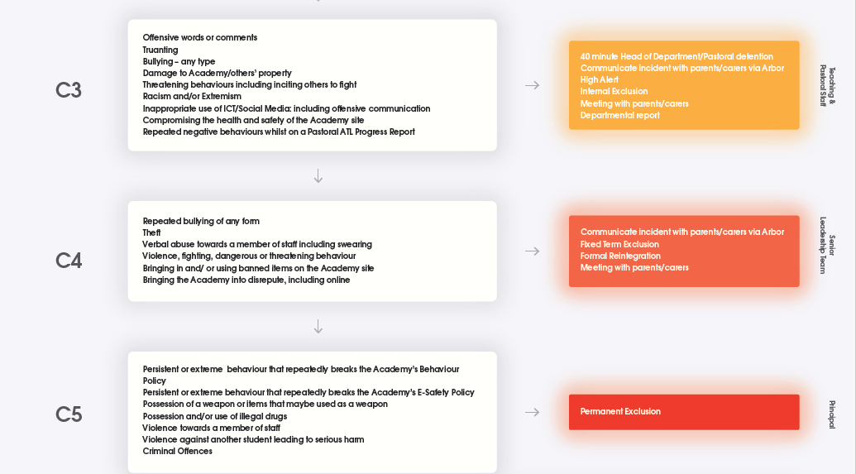
Professional Behaviour Policy
Department detentions

Slide 36
C5 banned items
Any student possessing alcohol, drugs, selling or passing on alcohol or drugs to others or using alcohol or drugs may be permanently excluded.

Slide 37
KS5 Dress Code Policy
No extremely ripped jeans, short skirts or shorts
No off the shoulder, cropped or belly tops
No stomachs or back exposed
No exposed cleavage, thighs, bottoms or underwear
No low - slung trousers/tracksuit bottoms or jeans
No flip flops or sliders
No baseball caps, beanies, any form of hat or hoods up worn during lessons, g: Talk lectures or workshops
Outerwear should not be worn in class, workshops or g: Talk lectures
Free Lockers
Lanyards MUST be worn visibly around necks for whole school
Safeguarding purposes

Slide 38
Incorrect Dress Code Consequences
KS5 will be asked to follow the dress code e.g., change into GA PE kit
recorded on Student Profile
repeat policy breakers are reported to Industry Mentors
possibility of missing a wide range of media opportunities
Risk being sent home

Slide 39
Support
KS5 Mentor
KS5 Pastoral Lead
Designated Safeguarding Leads
Mental Health 1st Aid staff
SENCO
School Nurse
Wellbeing dog
Medical Needs Coordinator
Wellbeing Advisor (limited)
School Counsellor (limited)
Safer Schools Police Officer
Referrals to Local Authorities
Official Young Carer
Bursary

Slide 40
Life after Global Academy
JJ

Slide 41
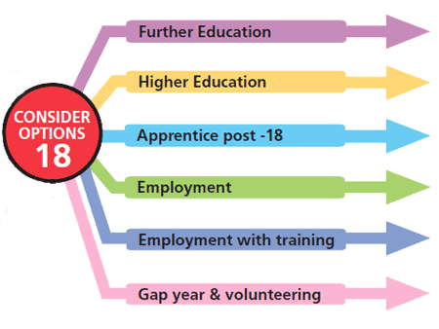
Still lots of time to decide (and change!)

Slide 42
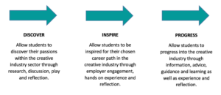
Starting to prepare …..
Industry Experiences, Opps and WEX
G Weekly
G Prep
Careers Advisor 1-2-1
Media Mentor
Careers Fair
Alumni
All Year 12 students will get a 121 appointment with Indie Nizzar (Trained Careers Advisor) in Year 12 and Year 13 with a Personal Progression Action Plan.
Indie is always available for drop ins too! | indie.Nizzar@globalacademy.com

Slide 43
Q&A

